Slide 1

HCSC: Hierarchical Contrastive Selective Coding
CVPR 2022
Wei Rukai| HUST
1

Slide 2


Background-SSL & Pretext task
Self-supervised pre-training
Encoder
tune
Pretext task
representations
Detection
Segmentation
Retrieval
...
Notes:
从头训练一个模型的代价是很昂贵的

Slide 3
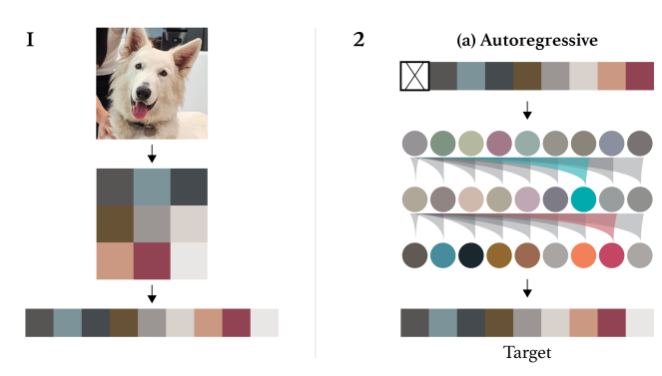

Background-SSL & Pretext task
Self -prediction
Image GPT
WaveNet
[1] Generative Pretraining from Pixels, ICML, 2020.
[2] WaveNet: A generative model for raw audio, SSW, 2016.

Slide 4
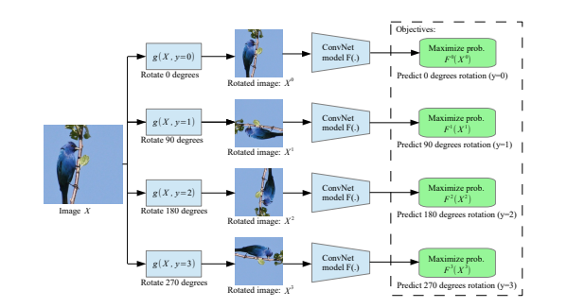
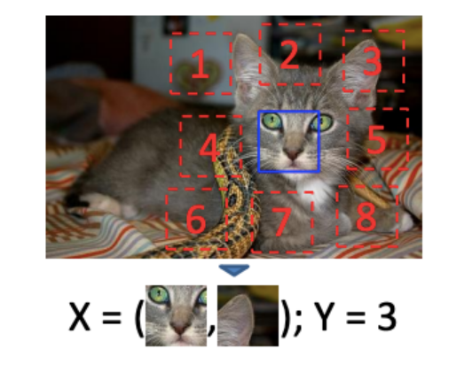
Background-SSL & Pretext task
Image rotation prediction
Relative position prediction
Rotate the images randomly by 0, 90, 180, or 270 degrees and make the model predict the amount of rotation.
predict the relative position of patches extracted at random from the same image
[1] Unsupervised Representation Learning by Predicting Image Rotations, ICLR, 2018.
[2] Unsupervised Visual Representation Learning by Context Prediction, NIPS, 2015.

Slide 5
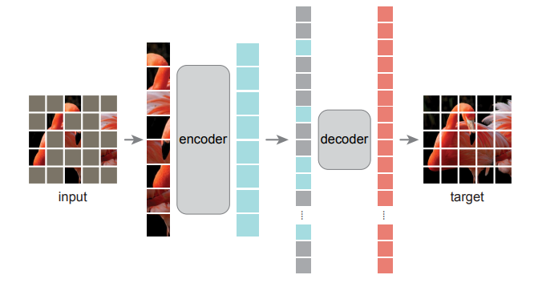
Background-SSL & Pretext task
Masked Image Modeling (MIM)
MAE
[1] Masked Autoencoders Are Scalable Vision Learners, 2022, CVPR
Notes:
将图像分割成一个个小块patch，随机对其中的一些小块进行遮蔽，然后将没有遮蔽的像素块按顺序排列，送入Transformer Encoder中，获得特征向量；之后将遮蔽的像素块（只包含位置信息）按原来的位置插入特征向量中，再放入Decoder中，由Decoder重构像素信息，生成原始图片。注意到，图中的Encoder比Decoder大一些，是因为Encoder是一个标准的Transformer编码器，计算量比较大，而Decoder结构就比较简单了。
解码器输出可以reshape成原来的patch，通过MSE计算重构损失，预测缺失信息

Slide 6
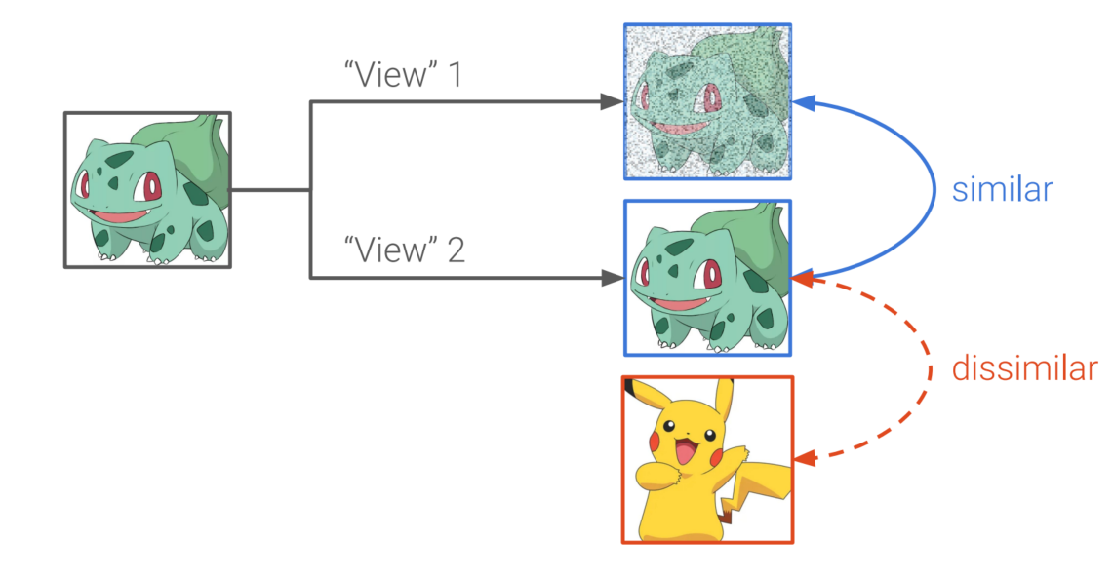
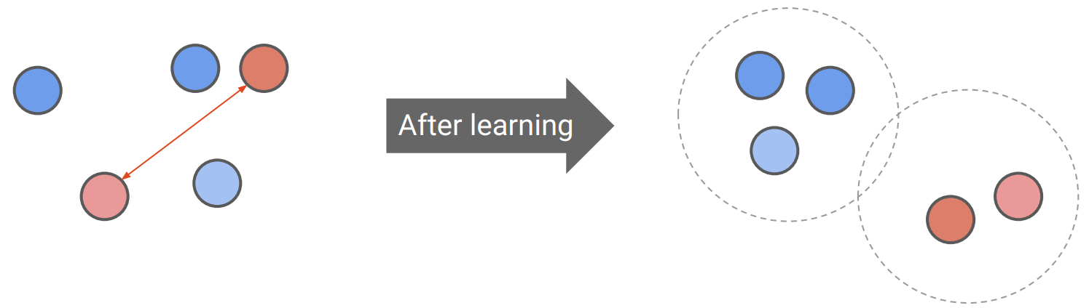
Background-SSL & Pretext task
Contrastive learning
Maximize the agreement between different views of the same image.
Attract positive pairs and repulse negative pairs.
Learn view/distortion-invariant representations.

Slide 7
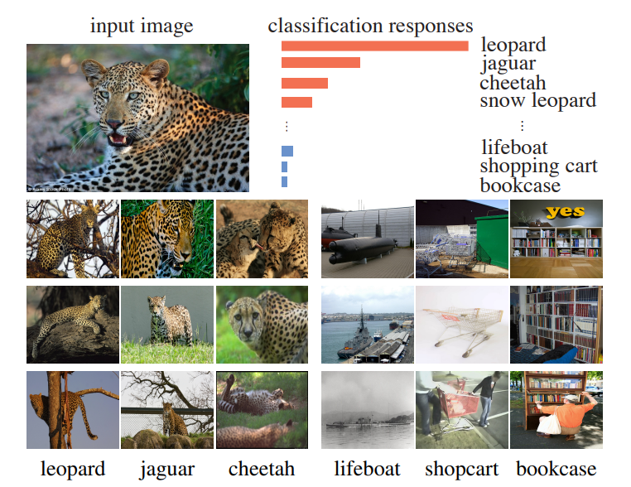
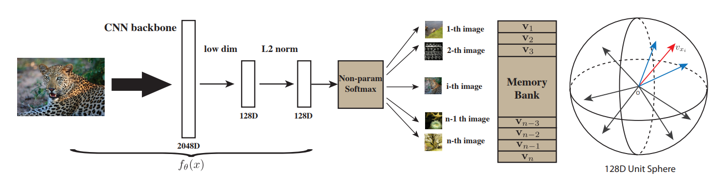
Background-Contrastive Learning
InstDisc
Motivation:
It is not the semantic labeling, but the apparent similarity in the data
themselves that brings some classes closer than others.
Instance discrimination:
Take the class-wise supervision to the extreme and learn a feature representation that discriminates among individual instances
[1] Unsupervised Feature Learning via Non-Parametric Instance Discrimination
Notes:
相似的图像聚集并不是因为他们有相同的标签，而是视觉上本身具有相似性，
正样本就是数据经过数据增强的样本，负样本是从memory bank中采样得到的，即数据中的其余图片
Memory bank中存放数据特征，每次从memory bank中随机采样出4096个负数样本，NEC loss 更新CNN网络

Slide 8
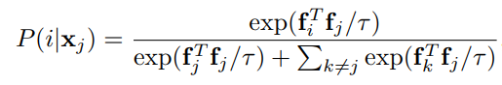
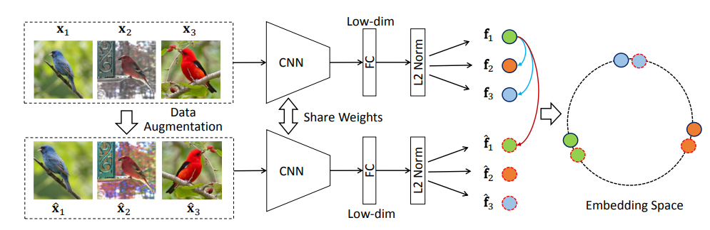
Background-Contrastive Learning
InvaSpread
Perform contrastive learning with negative samples in a mini-batch.
Share weights between Siamese networks.
Update CNN parameters with InfoNCE loss,
[1] Unsupervised Embedding Learning via Invariant and Spreading Instance Feature
Notes:
Batch size 256 太小
Augmentation的手段不够强

Slide 9
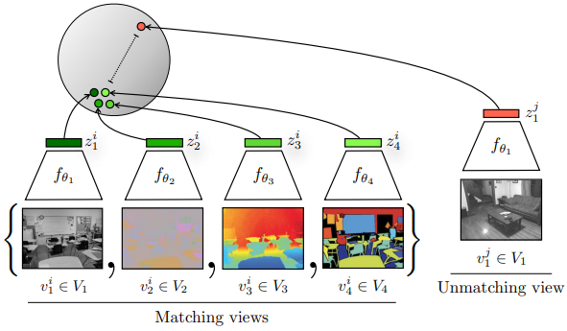
Background-Contrastive Learning
CMC
Each view is noisy and incomplete.
A powerful representation is one that models view-invariant factors.
Maximize mutual information between different views of the same scene.
[1] Contrastive Multiview Coding, ECCV, 2020.
Notes:
人类通过许多感官通道来观察世界，例如，左眼观察的长波光通道，或者右耳听到的高频振动通道。每一个视角（感官）都是有噪声而且不完整的，而一个良好的表征应该是在不同的视角下得到都是一样的

Slide 10
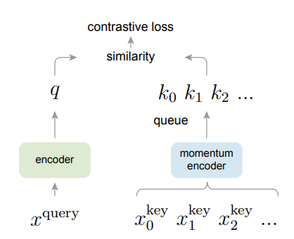
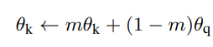
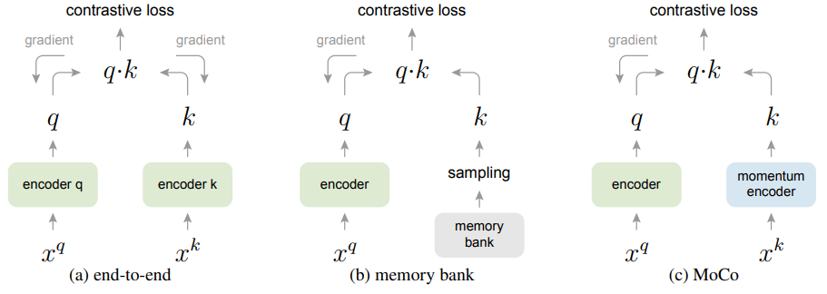
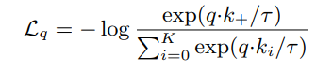
Background-Contrastive Learning
MoCo
Dynamic dictionary
Momentum encoder
Contrastive Learning as Dictionary Look-up
out
in
new momentum features
queue
[1] Momentum Contrast for Unsupervised Visual Representation Learning, CVPR, 2020

Slide 11
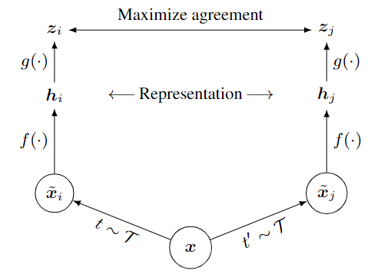
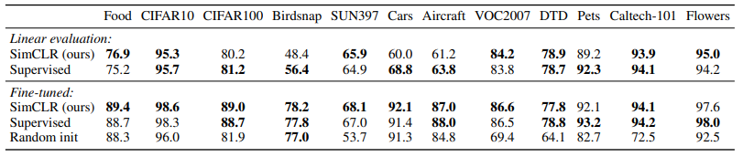
Background-Contrastive Learning
SimCLR
A projector(MLP)
Larger batch size
More augmentation strategies
[1] A Simple Framework for Contrastive Learning of Visual Representations, ICLR, 2020.

Slide 12
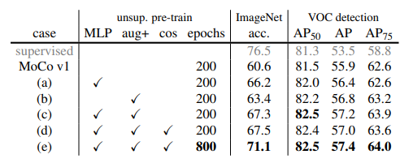
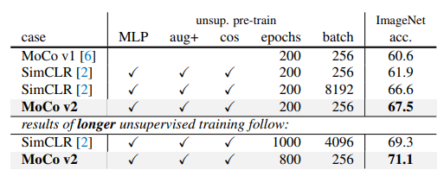
Background-Contrastive Learning
MoCo V2
SimCLR V2
Momentum encoder
Larger backbone model
Deeper projector

Slide 13
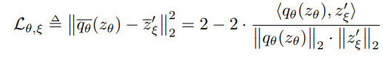
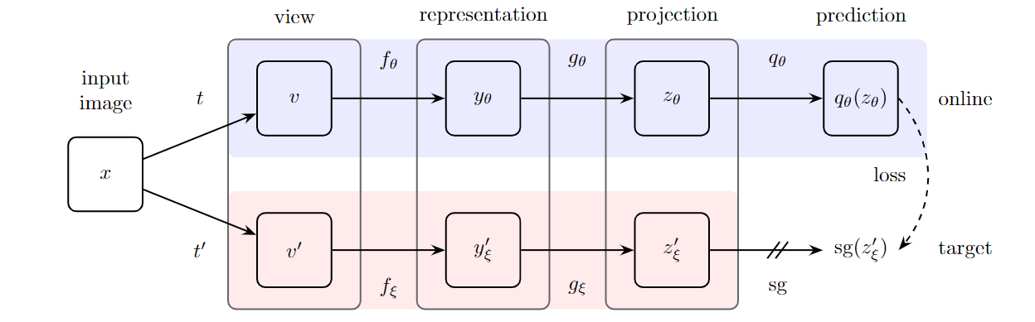
Background-Contrastive Learning
BYOL
Train the model with only positive pairs will lead to a trivial solution. (collapse)
Online network (predictor) + target network
Momentum encoder
Mean square error
No negative sampling
[1] Bootstrap Your Own Latent: A New Approach to Self-Supervised Learning, NIPS, 2020

Slide 14

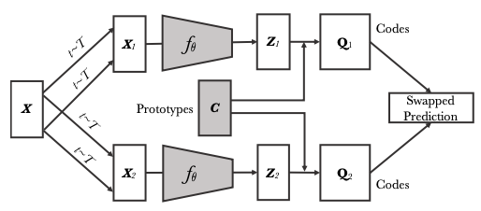

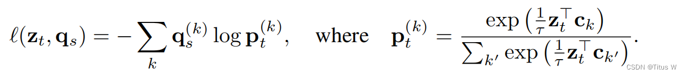
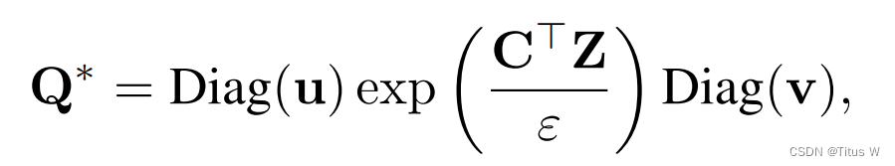
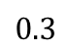
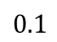
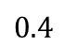
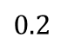
Background-Contrastive Learning
SwAV
$$0.1$$
$$0.3$$
$$0.2$$
$$0.4$$
Cross-entropy loss
Sinkhorn-algorithm
[1] Bootstrap Your Own Latent: A New Approach to Self-Supervised Learning, NIPS, 2020

Slide 15
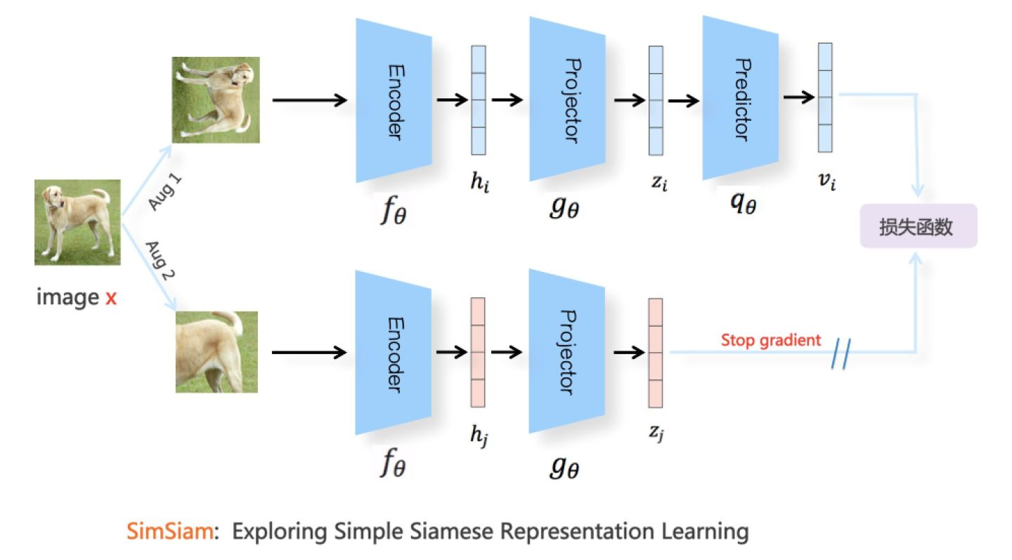
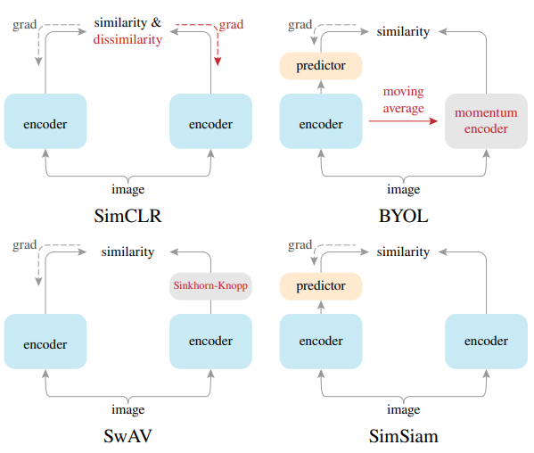
Background-Contrastive Learning
SimSiam
Negative sampling
Large batch size
Momentum encoder
Stop gradient
Asymmetric structure
[1] Exploring Simple Siamese Representation Learning, CVPR, 2021.

Slide 16
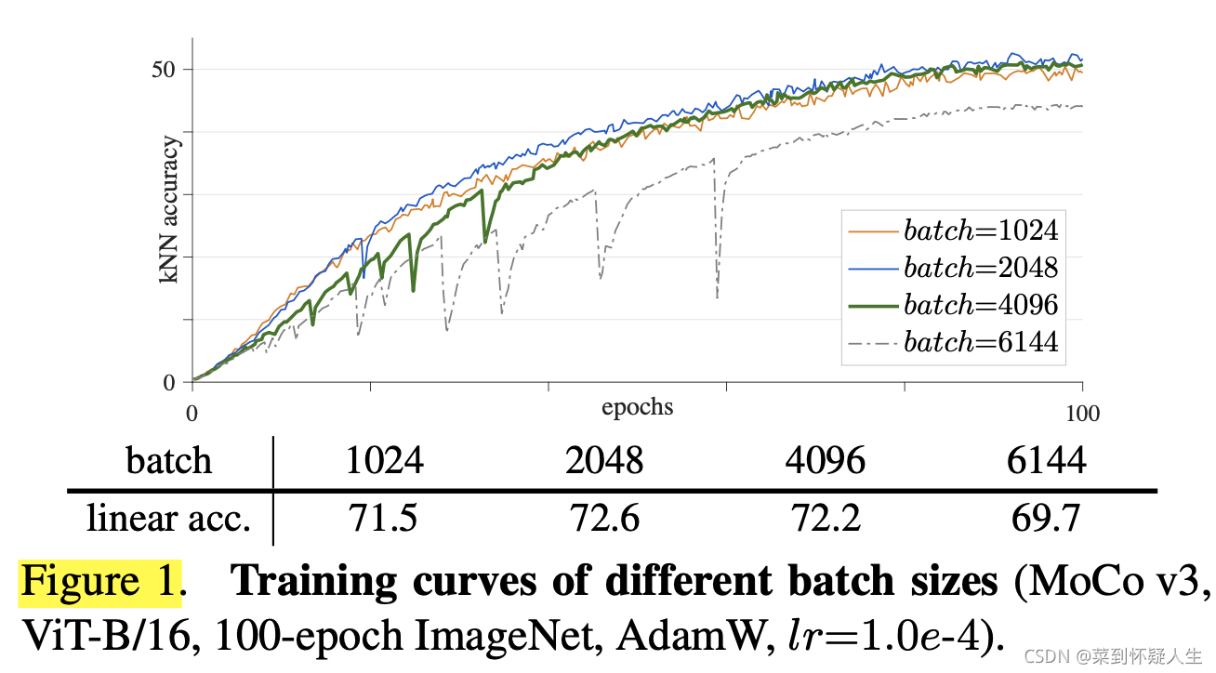
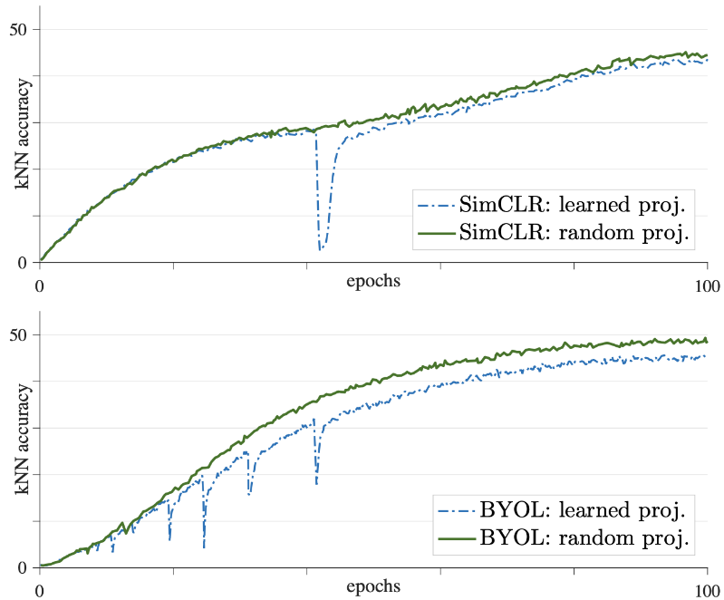
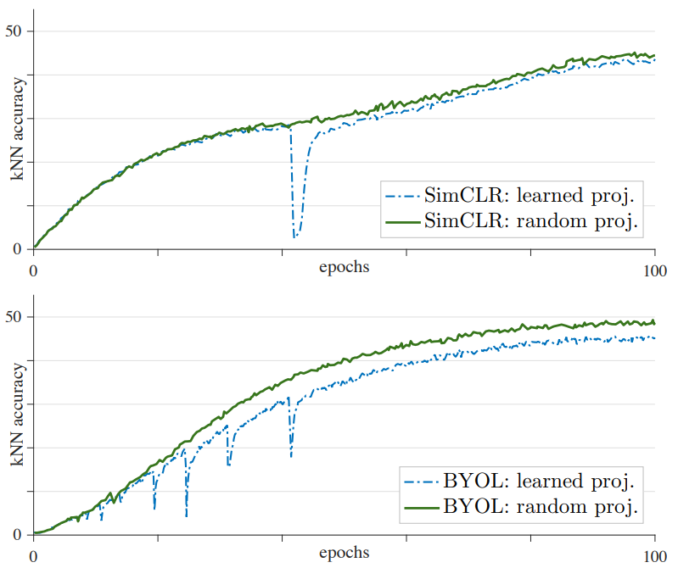
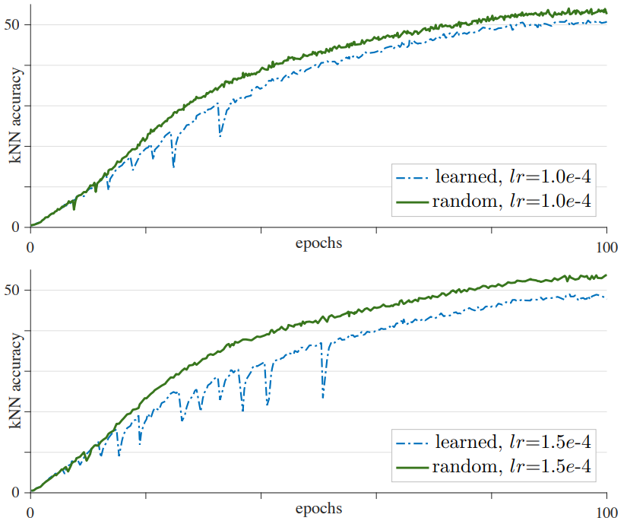
Background-Contrastive Learning
MoCo V3
Instability is a major issue that impacts self-supervised ViT training.
Fix the patch embedding layer.
[1] An Empirical Study of Training Self-Supervised Vision Transformers, ICCV, 2021
Notes:
Abstract：This paper does not describe a novel method. Instead, it studies a straightforward, incremental, yet must-know baseline given the recent progress in computer vision: self-supervised learning for Vision Transformers (ViT).
详细探讨了batch size，learning rate ， optimizer对该现象的影响，

Slide 17
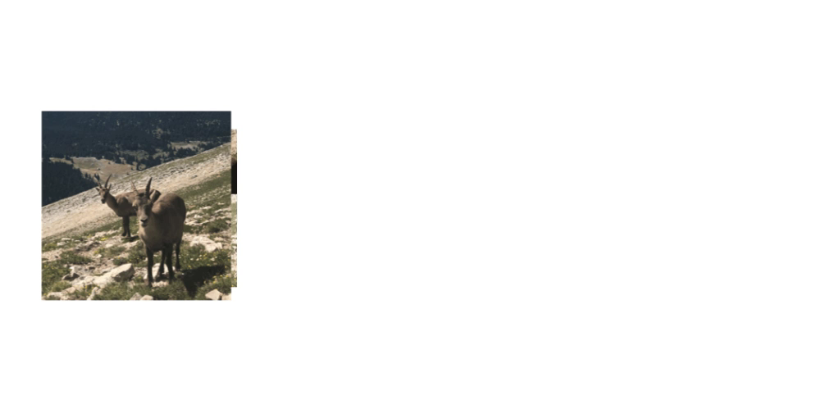
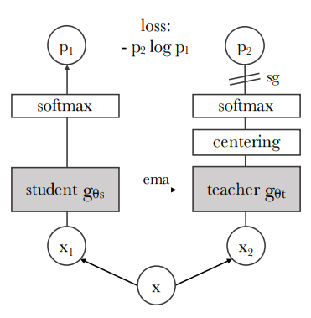
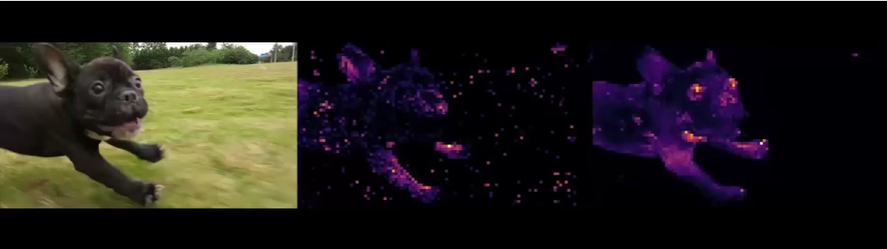
Background-Contrastive Learning
DINO
origin
Supervised segmentation
DINO
Notes:
Abstract：This paper does not describe a novel method. Instead, it studies a straightforward, incremental, yet must-know baseline given the recent progress in computer vision: self-supervised learning for Vision Transformers (ViT).
详细探讨了batch size，learning rate ， optimizer对该现象的影响，

Slide 18
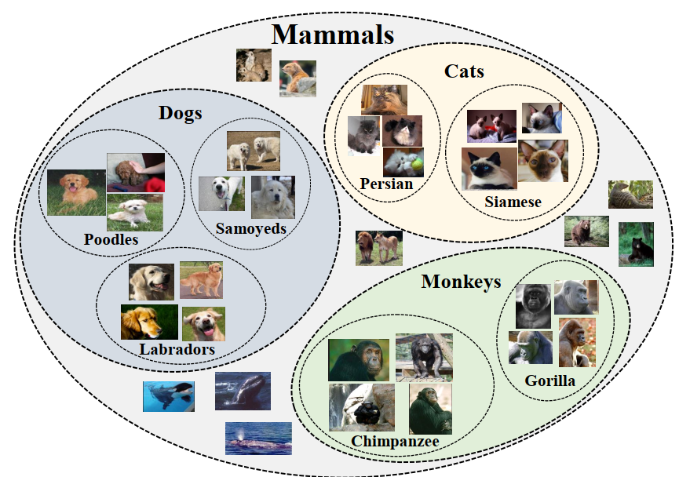
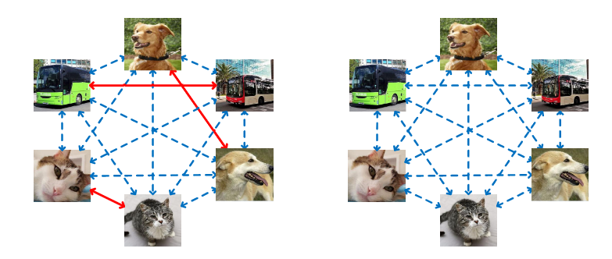
HCSC: Motivation
Hierarchical semantic structures naturally exist in an image dataset.
The negative pairs used in these methods are not guaranteed to be semantically distinct.
motivation 1
motivation 2

Slide 19
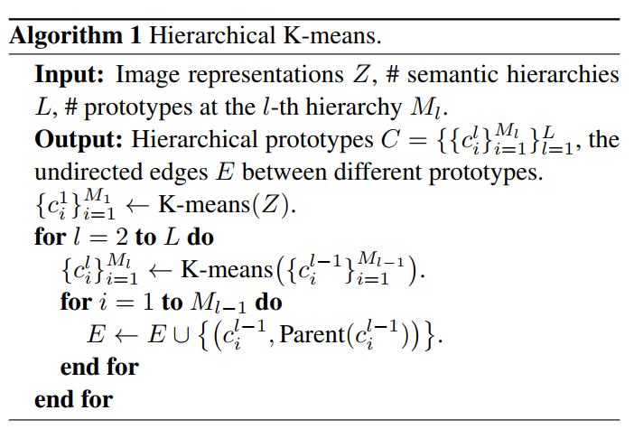
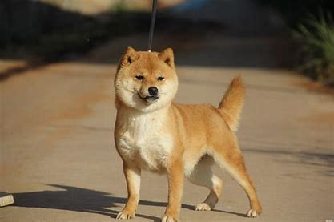
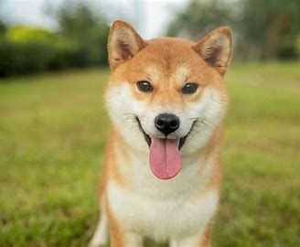
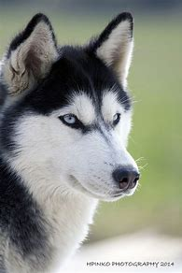

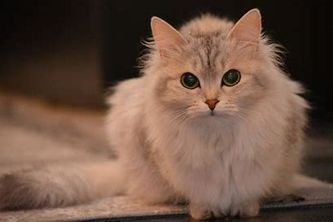
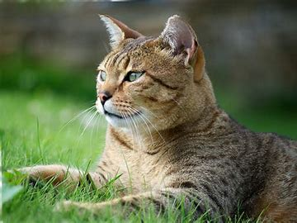

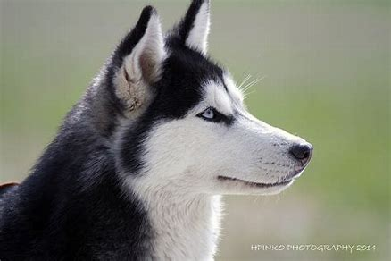
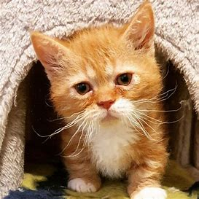
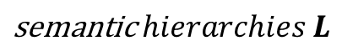
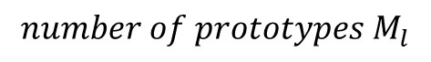
HCSC: Hierarchical K-Means
Extract feature representations of all images in the dataset by the image encoder.
Perform K-Means with momentum features to obtain the prototypes of the first hierarchy.
Perform K-Means with all prototypes of hierarchy below to obtain prototypes of each higher hierarchy.
$$\text{semantic} hierarchies L$$
$$number of prototypes M_{l}$$

Slide 20
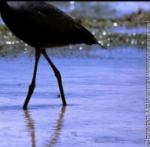





HCSC: Instance-wise Contrastive Learning
P
N
N
N
Positive: features of self-augmented views.
Negative: features in the momentum queue.
encoder
momentum
encoder
Bernoulli sampling on each negative candidate
query

Slide 21










HCSC: Instance-wise Contrastive Learning
query/anchor
$s\left(z,c\right)=z⋅\frac{c}{τ_{c}}, τ_{c}=\frac{\sum_{z_{i}∈Z_{c}}{{\left|\left|z_{i}−c\right|\right|}_{2}}}{\left|Z_{c}\right|\log\left(\left|Z_{c}\right|+ε\right)}$
$$p_{select}^{l}\left(z_{j},z\right)=1−\frac{exp⁡[s(z_{j},c^{l}(z))]}{\sum_{i=1}^{M_{l}}{exp⁡[s(z_{j},c_{i}^{l})]}}$$
$$z:query, z_{j}:negative condidate,$$
$$M_{l}: number of clusters at level l$$
$$0.1$$
$$0.2$$
$$0.3$$
$$0.4$$
$$p=0.8$$
negative candidate
$$N_{select}^{l}\left(z\right)=\{ℬ(z_{j};p_{select}^{l}(z_{j},z))|z_{j}∈N\}$$
$$l_{m}$$
$$L_{ICSC}=E_{x\sim p_{d}}[\frac{1}{L}\sum_{l=1}^{L}{L_{info}(z,z^{′},N_{select}^{l}\left(z\right),τ)}]$$
$$l_{n}$$

Slide 22



HCSC: Prototypical Contrastive Learning
$$p_{select}^{l}\left(c_{j},c^{l}(z)\right)=1−\frac{exp⁡[s(c_{j},{Parent(c}^{l}\left(z\right)))]}{\sum_{i=1}^{M_{l}}{exp⁡[s(c_{j},c_{i}^{l+1})]}}$$
$$L_{PCSC}=E_{x\sim p_{d}}[\frac{1}{L}\sum_{l=1}^{L}{L_{protoNCE}(z,c^{l}(z),N_{select}^{l}\left(c^{l}\left(z\right)\right),\{τ_{c}\})}]$$

Slide 23

Q&A
Thanks！
Notes:
Thanks for listening!

